Slide 1
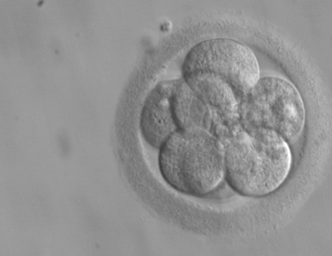







Cell Cycle and Cell Divisions

Slide 2
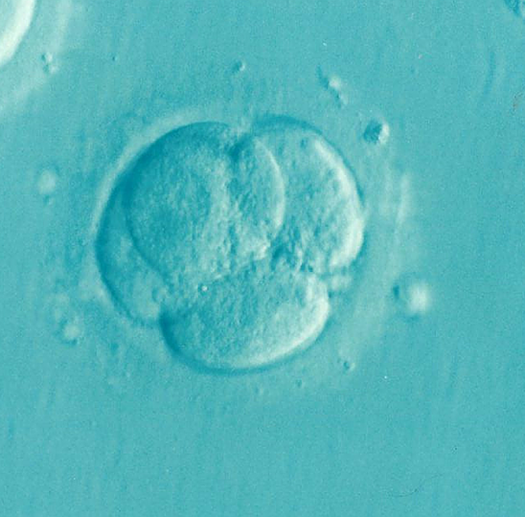
The single-celled entity then relies on cellular events to produce more cells, the early stage of which is shown in the blastula.

Slide 3
Further growth and development proceed through the continuous reproduction and specialization of cells. The process repeats for as long as needed to ensure the maintenance and survival of an individual.

Slide 4
How do our bodies replenish cells?

Slide 5
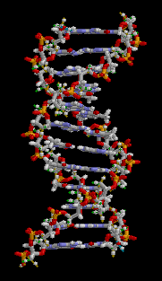
The Genetic Material of Cells
DNA Molecule
Almost every cell in our bodies has genetic material in the form of deoxyribonucleic acid (DNA).
Most biological traits such as eye color, hair color, and height are coded for by the DNA.
DNA is the genetic material
in living cells.

Slide 6
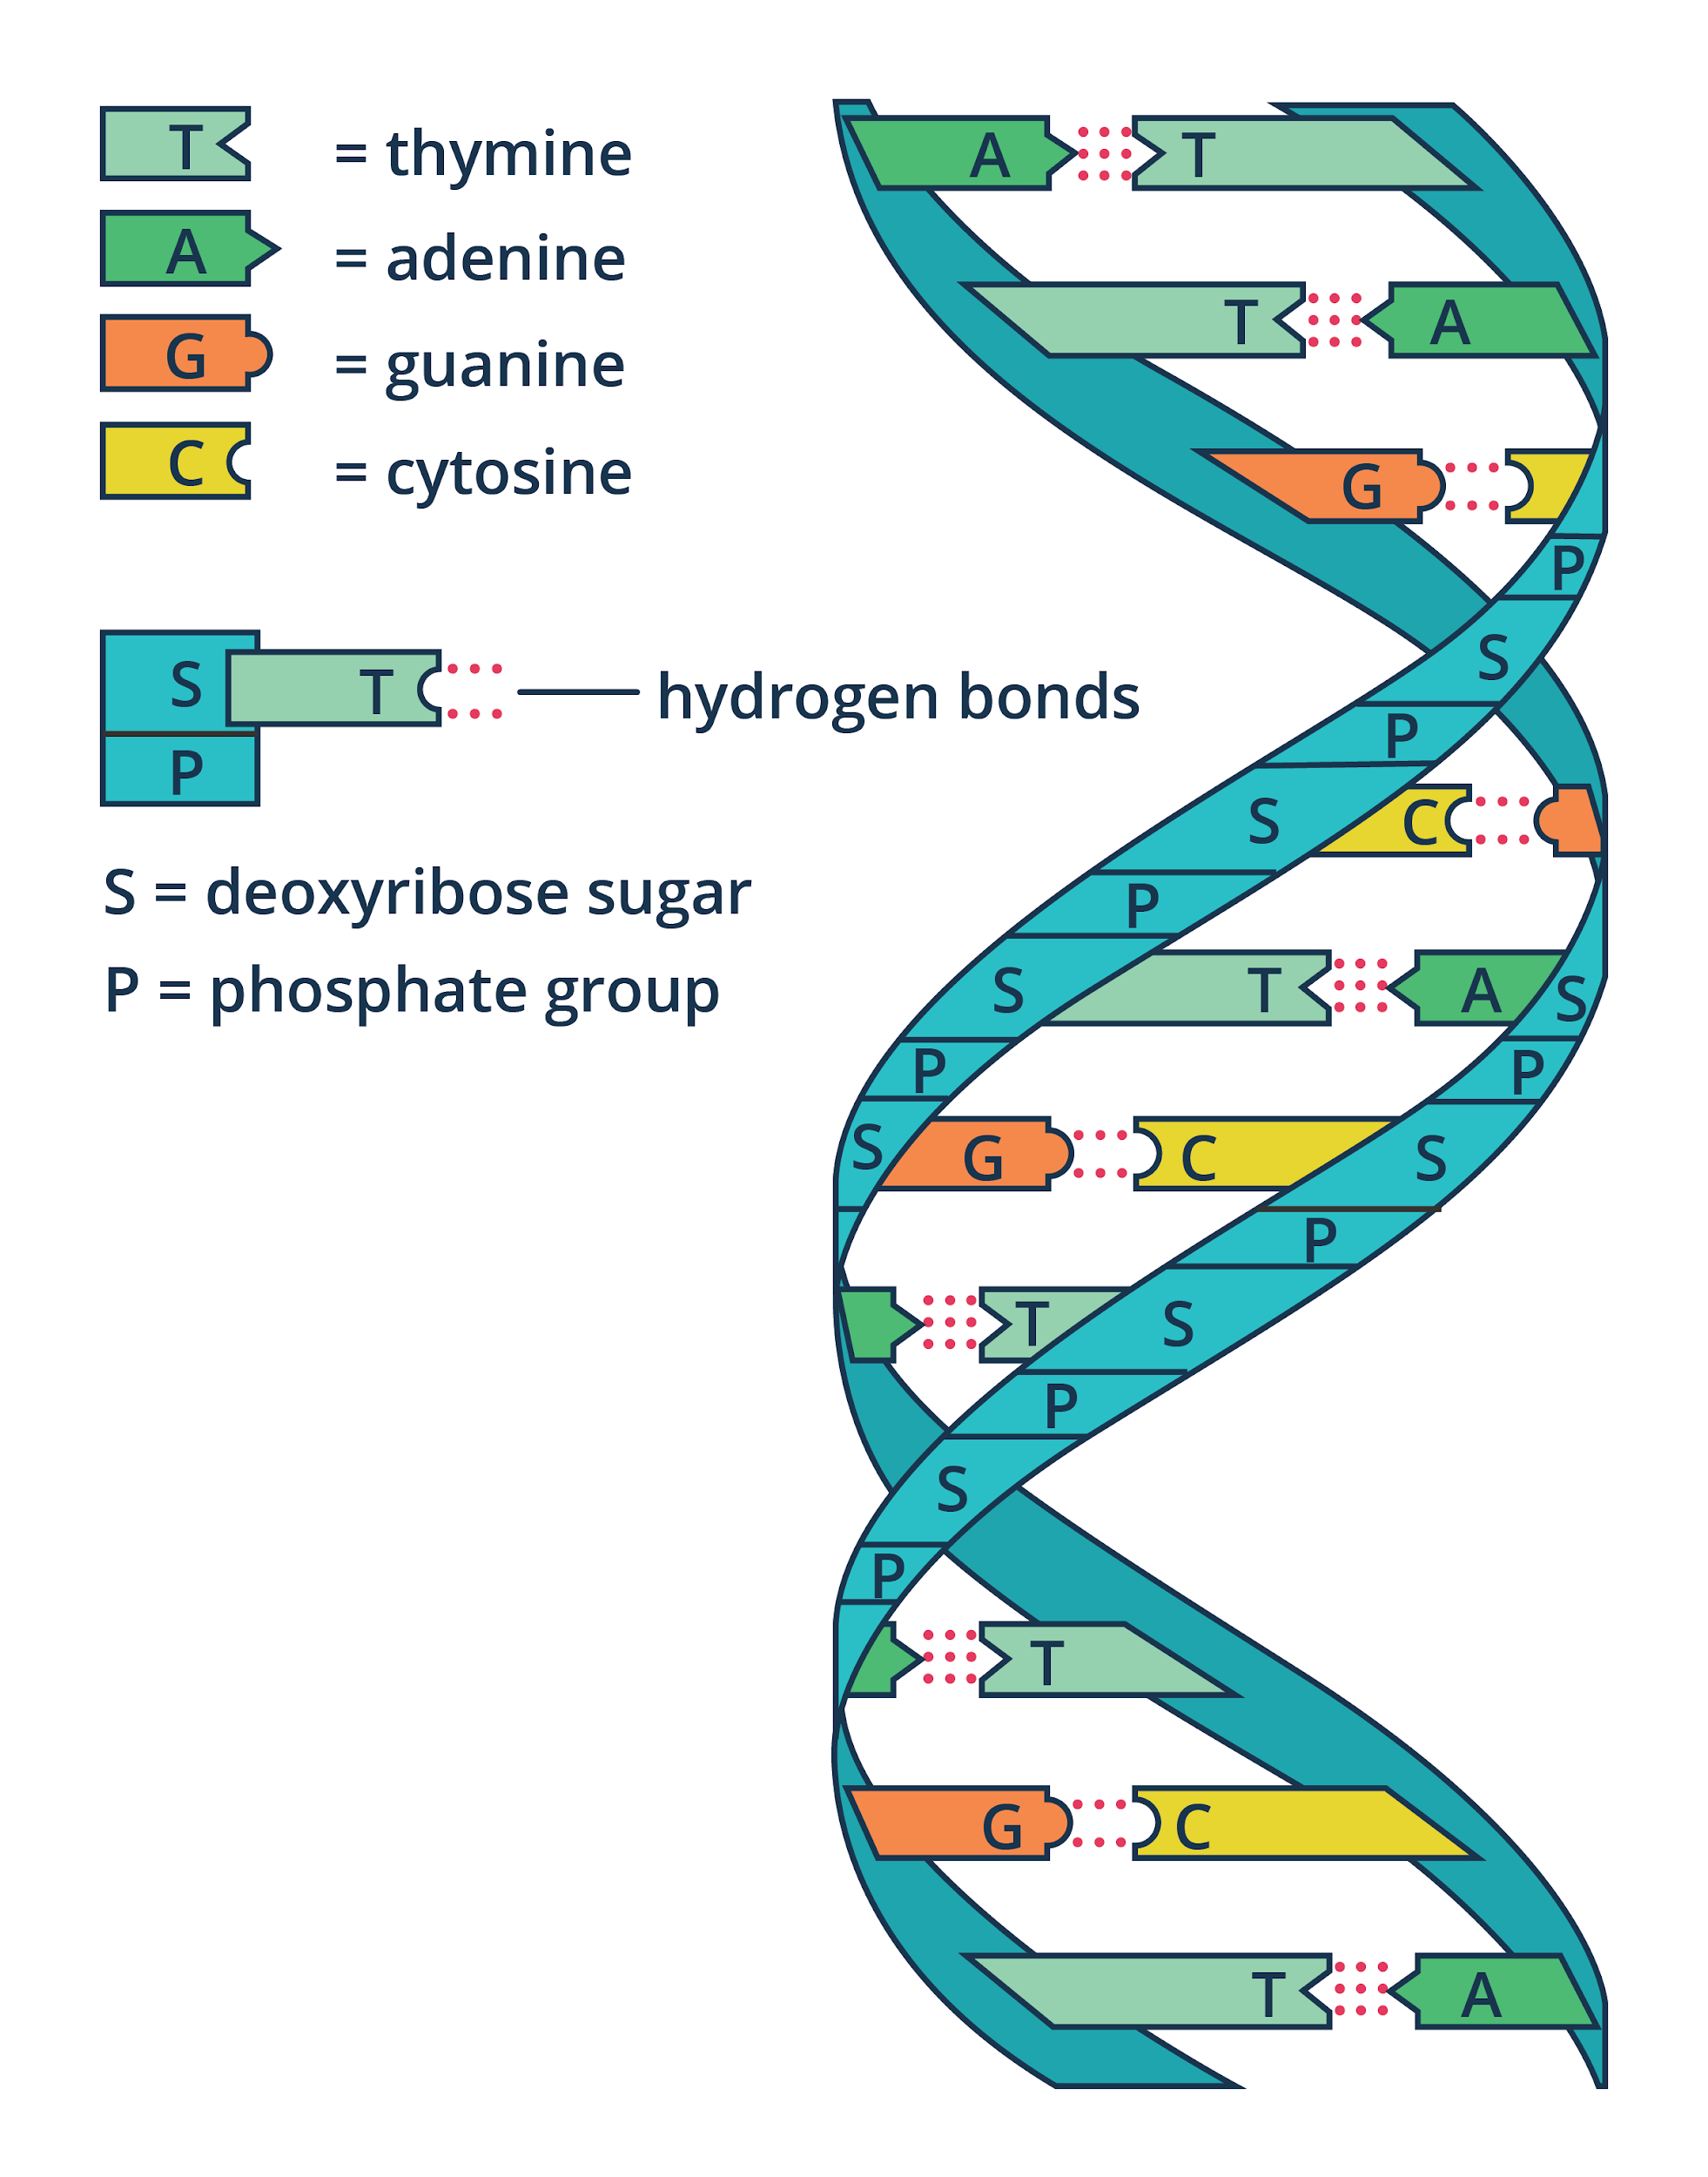
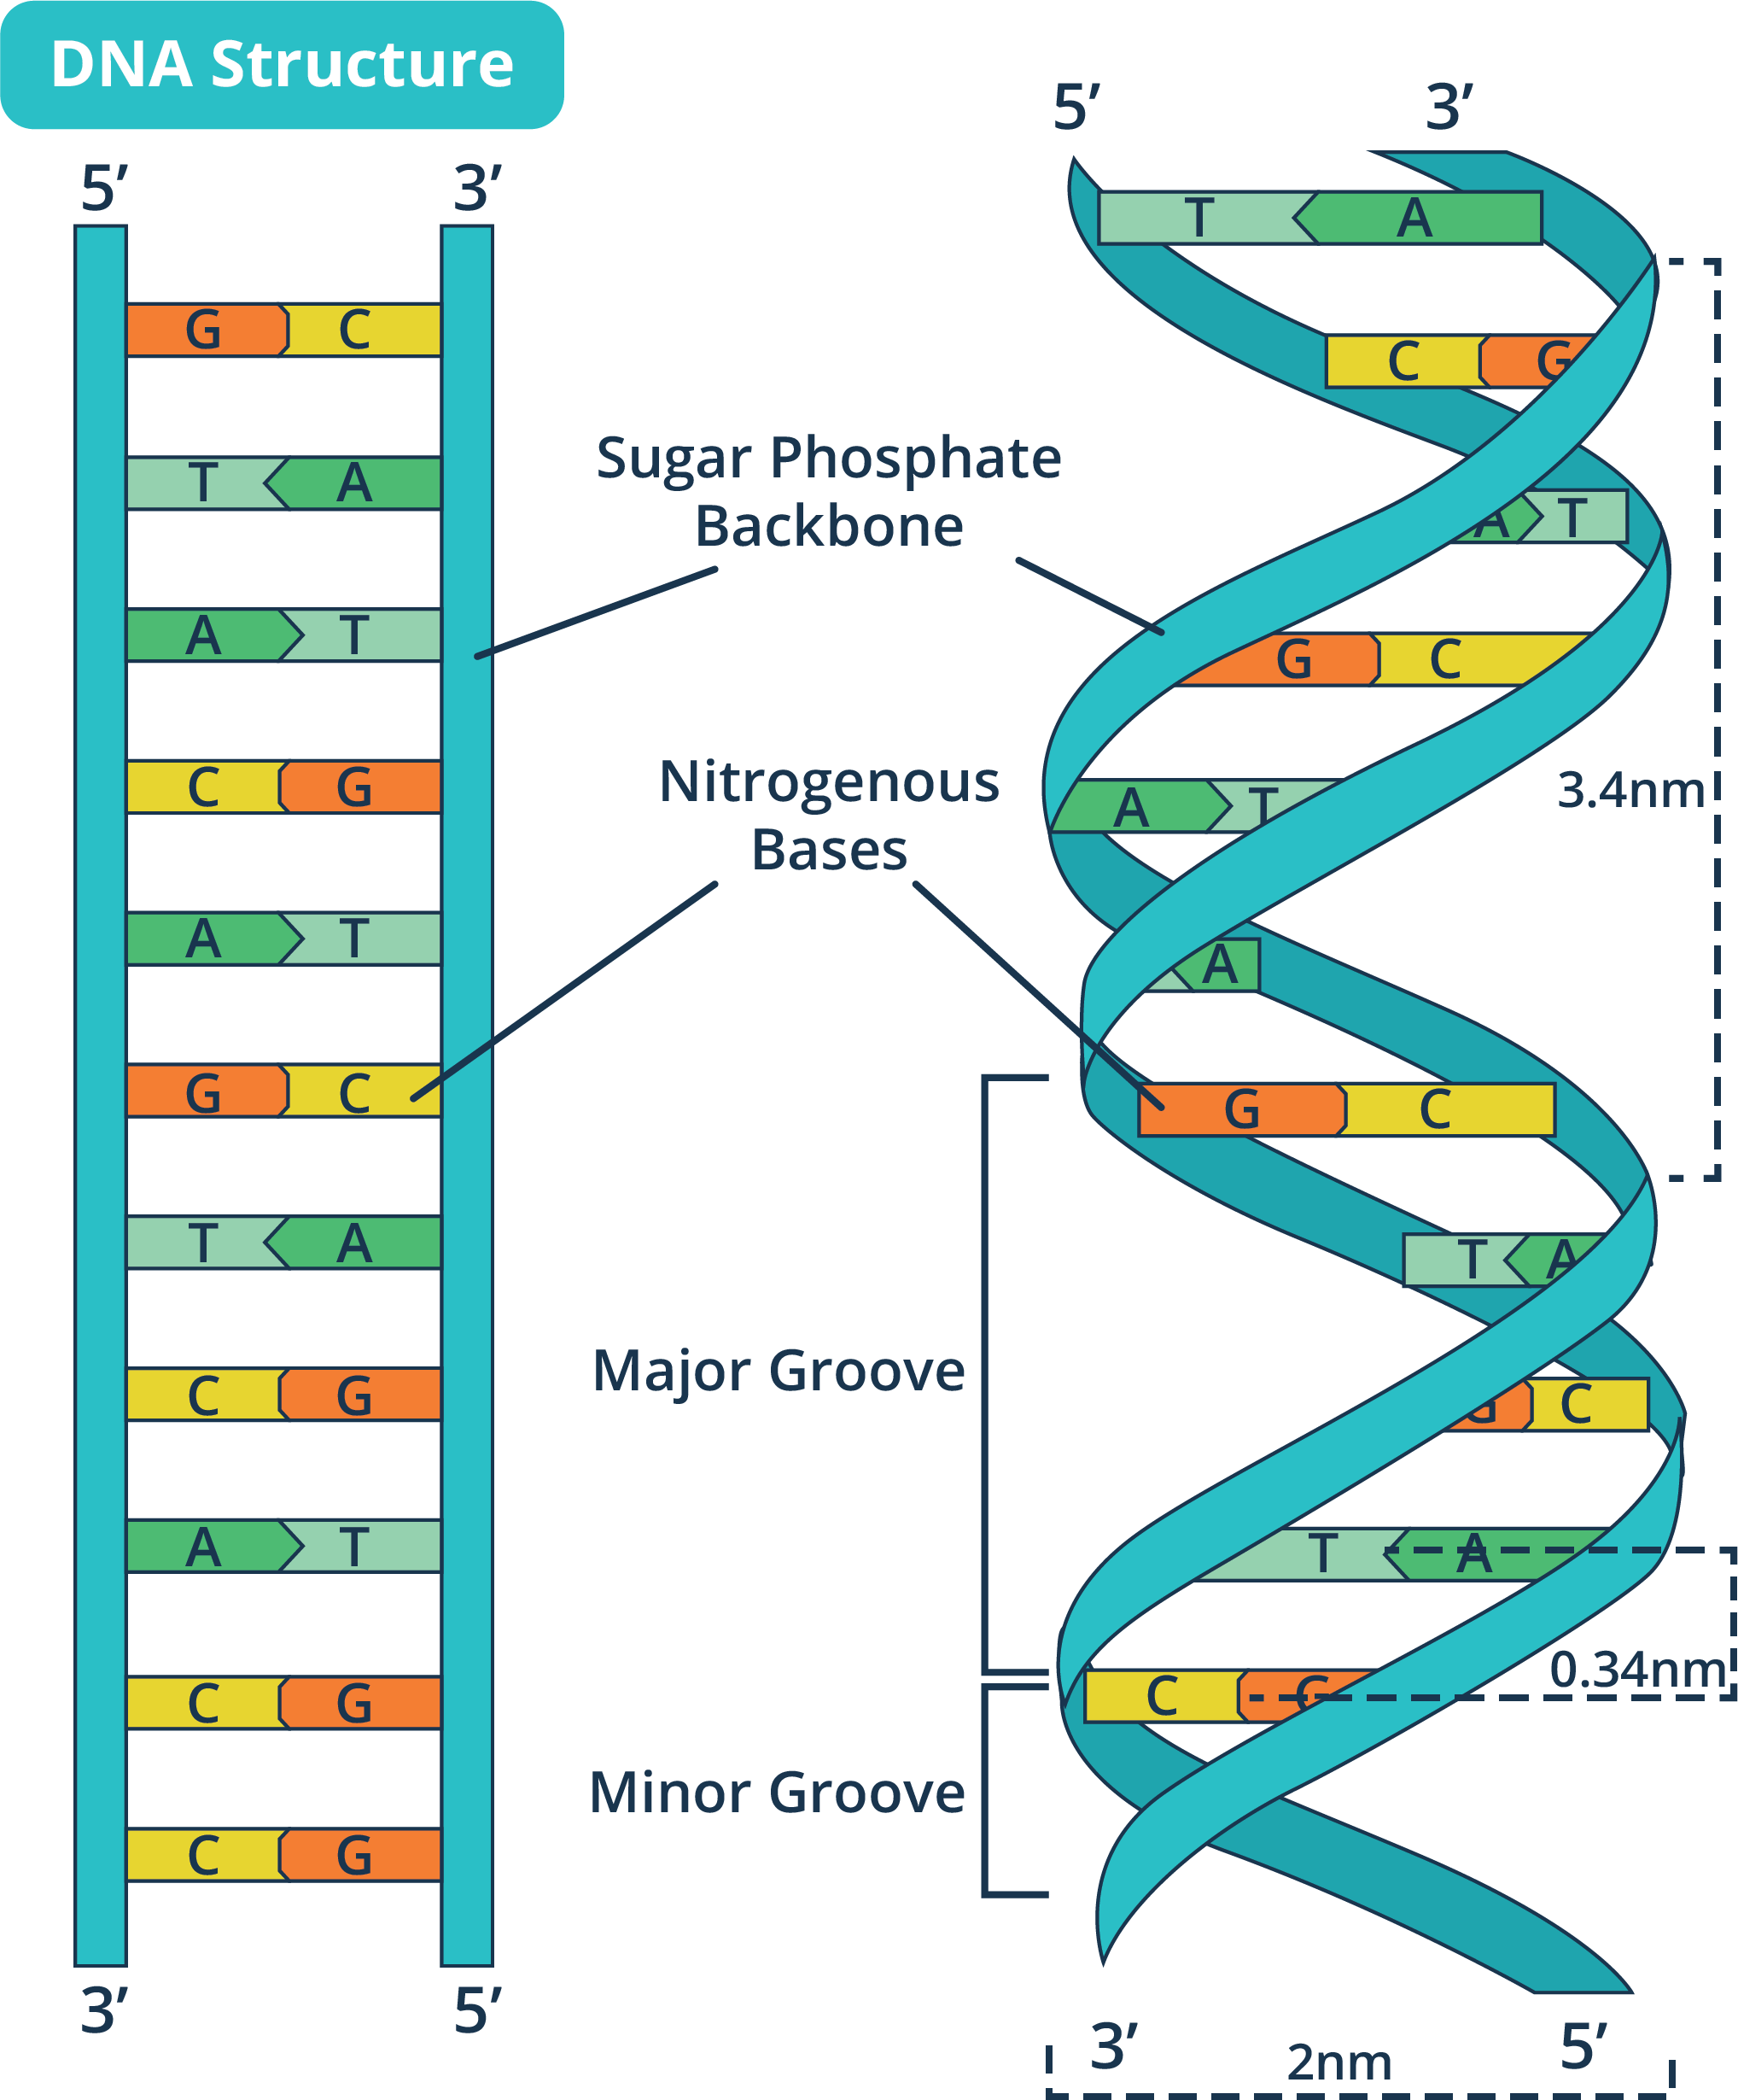
The Genetic Material of Cells
DNA, the primary genetic material of living organisms, stores genetic information in the sequences of its nucleotides.

Slide 7
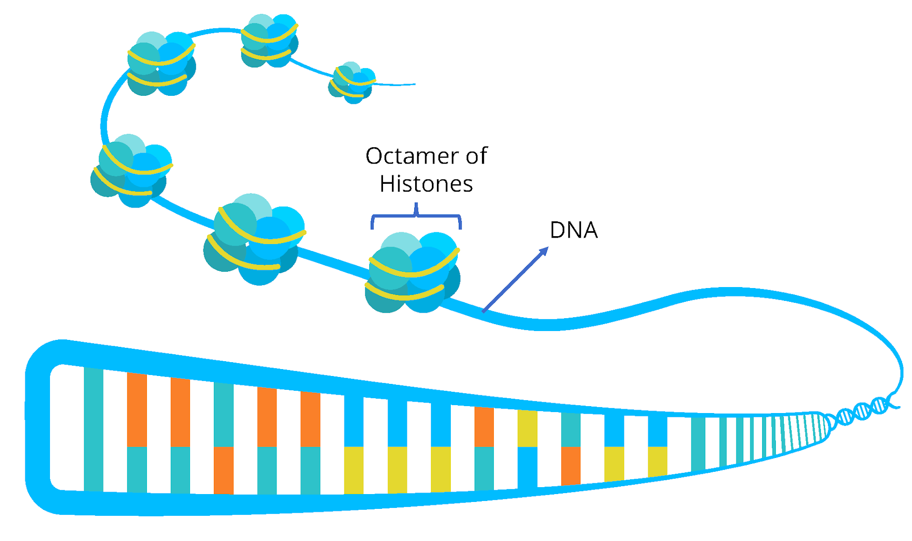
The Genetic Material of Cells
Positively charged histone proteins aid in DNA packaging.

Slide 8
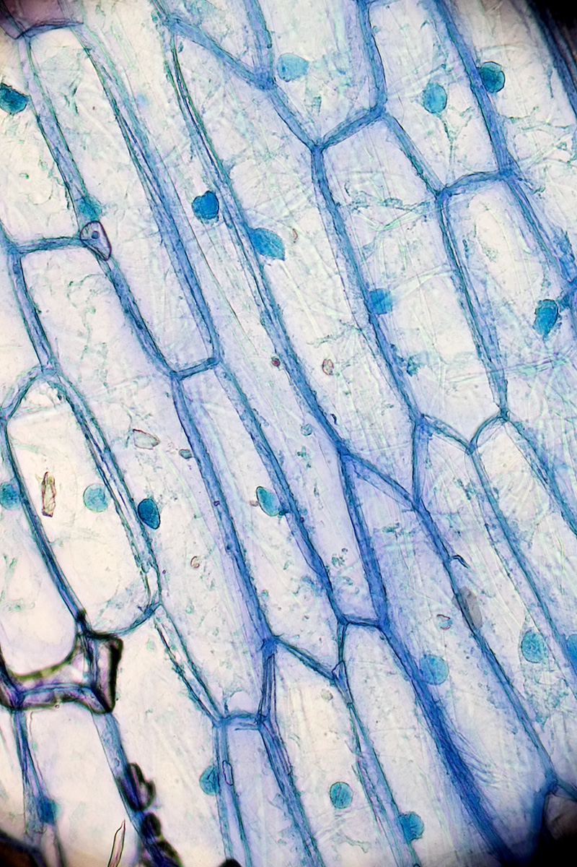
The Genetic Material of Cells
Chromatin
Interphase DNA is found in the form of chromatin, a complex of DNA and proteins.
Chromatin in dispersed inside the intact cell nucleus during interphase.
Interphase cells of onion

Slide 9
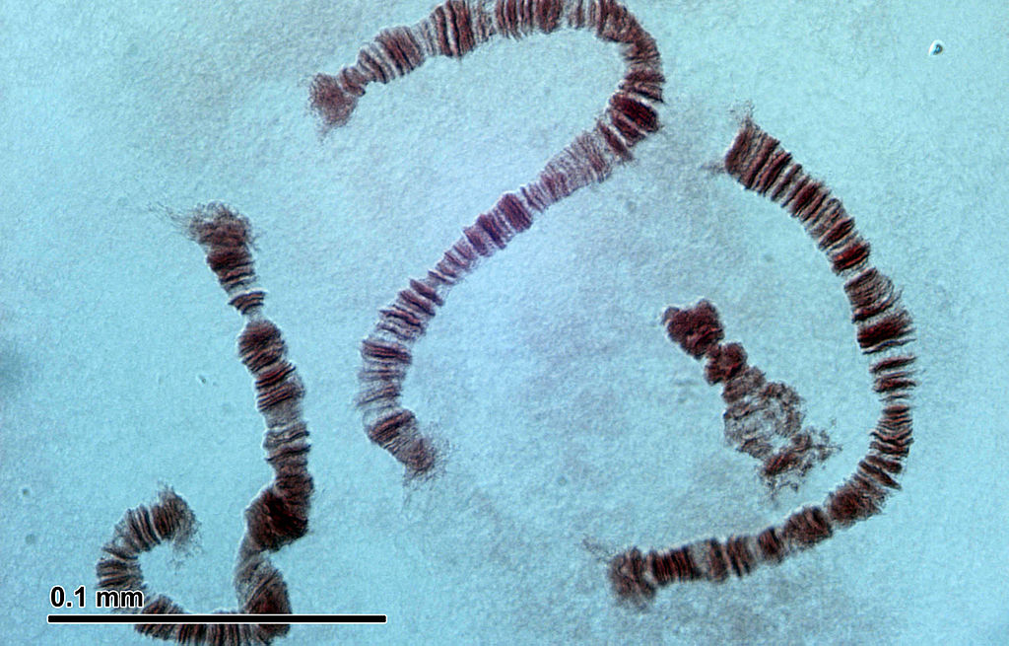
The Genetic Material of Cells
Chromosome
Chromatin will sometimes need to further condense into a highly coiled and compact structure. This highly condensed form of DNA is known as a chromosome.
Insect chromosomes are highly condensed structures when viewed under a microscope

Slide 10
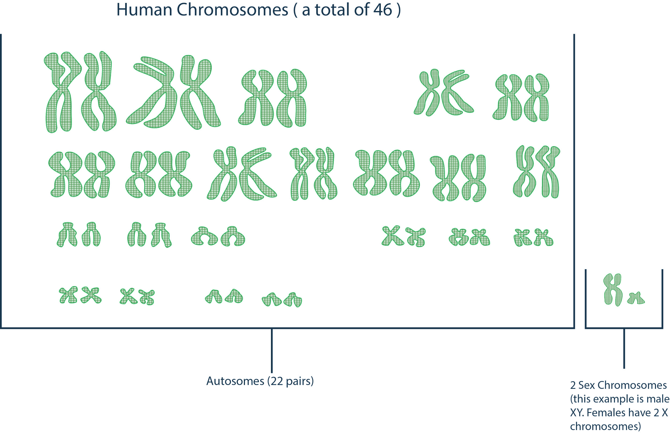
The Genetic Material of Cells
Humans have 46 individual
(or 23 pairs of) chromosomes.
Notes:
Chromosomes
DNA molecules are organized into paired discrete structures called chromosomes.
Each pair of homologous chromosomes are highly similar to each other, but still bear a few differences.
If DNA is replicated, each chromosome contains two identical halves, known as chromatids.
Each chromatid contains the exact same genetic material as the other half.

Slide 11
You are looking at a diploid cell which consists of four pairs of chromosomes. After DNA replication, how many chromatids are there? How many of these do you think are homologous?

Slide 12
Chromatin condenses into chromosomes. Each half of the chromosome is a chromatid.
To help you remember this, imagine the chromatin to be a very thin string of DNA. Imagine the string being wound up into a thick rope. This thick rope is the chromosome. Now, imagine each half of that rope to be similar to the other half. These halves are the chromatids.

Slide 13
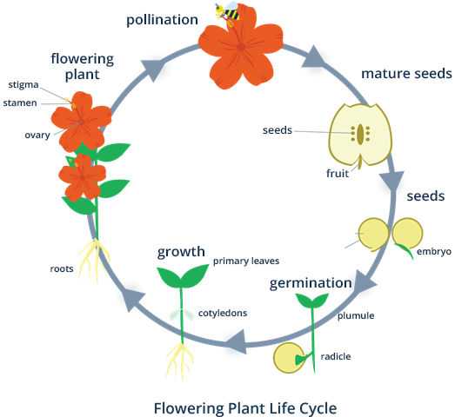
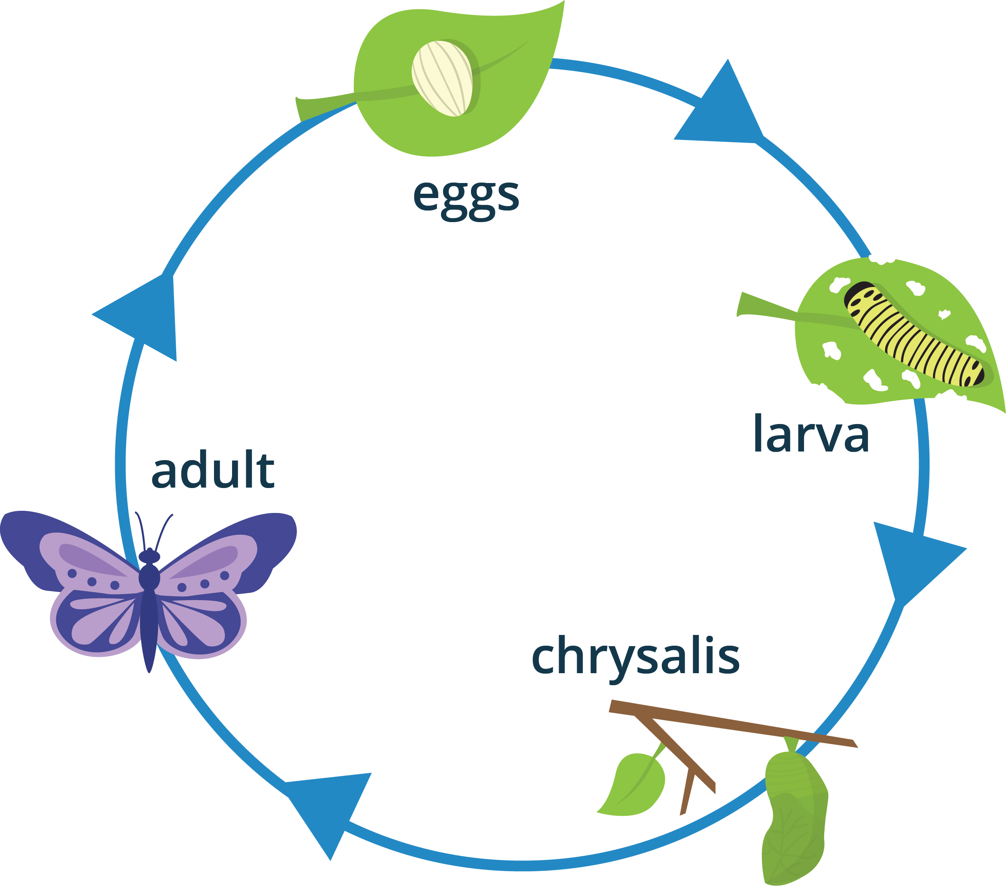
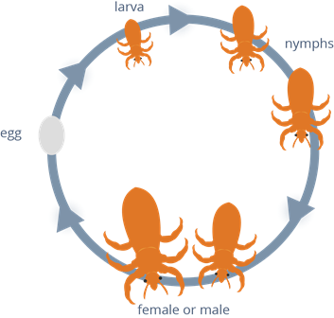
Introduction to Cell Cycle
All species of organisms have their own life cycle that shows how they are born, develop, and mature.
Life cycle of various organisms

Slide 14
Introduction to Cell Cycle
Much like entire organisms, individual cells also have their own life cycle. The life cycle of a cell is known as the cell cycle, and this describes how cells grow, develop, and reproduce.

Slide 15
What are the different phases of the cell cycle and how does the cell make sure that these phases proceed smoothly?

Slide 16
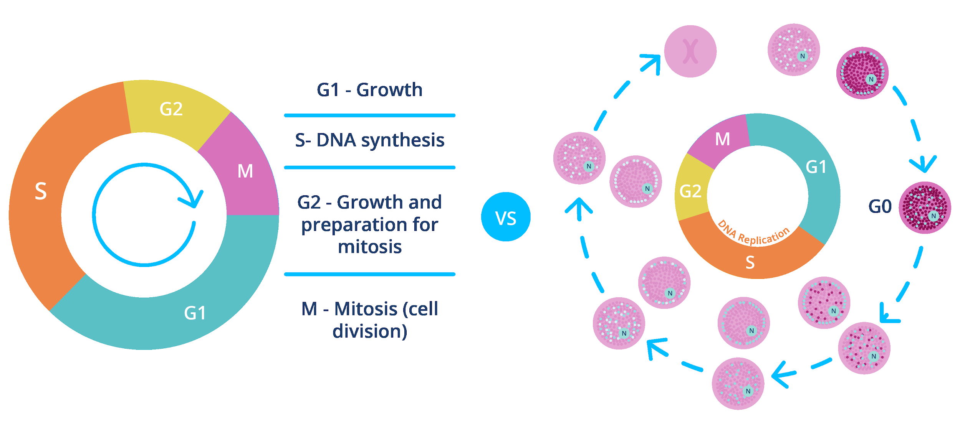
Introduction to Cell Cycle
The cell cycle involves different phases that constitute a series of preparations for a cell to divide to produce new cells.

Slide 17
Stages of the Cell Cycle
Interphase
Three Stages of the Cell Cycle
M phase
Cytokinesis

Slide 18
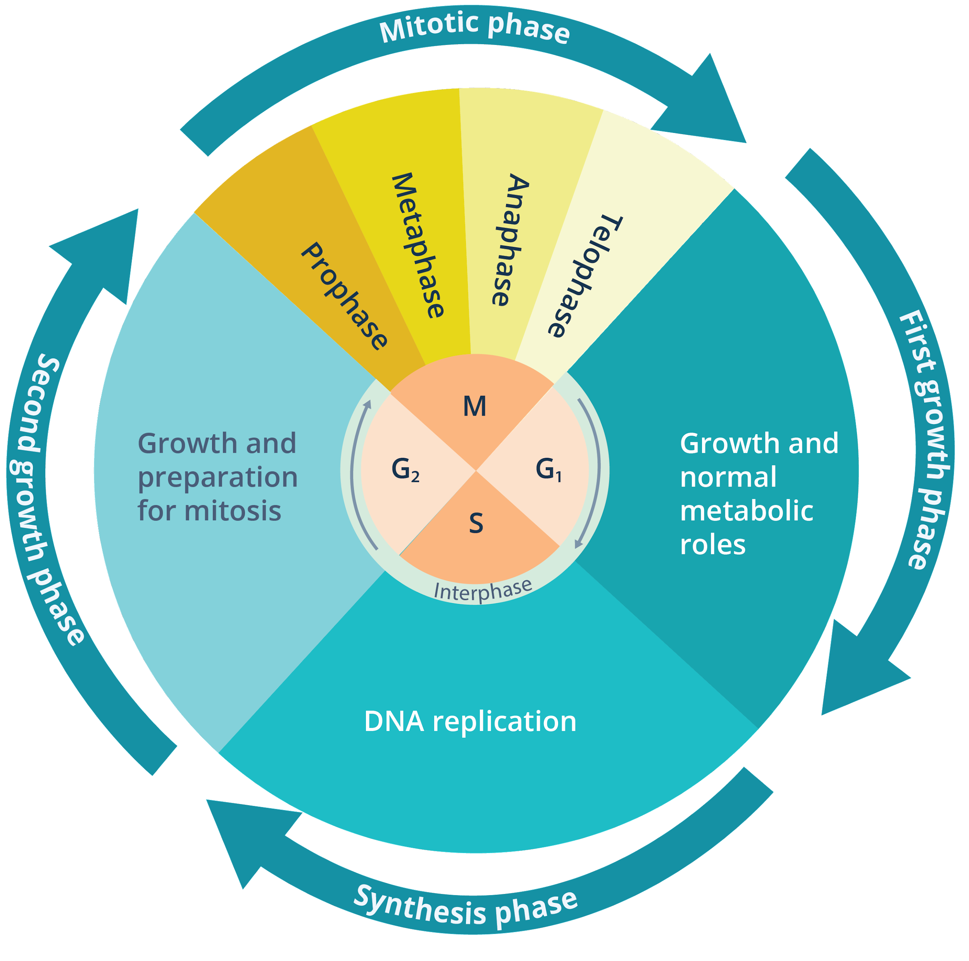
The Cell Cycle
Interphase - Gap 1
The phases of the cell cycle
Interphase - S
Interphase - Gap 2
M phase
Cytokinesis

Slide 19
The Cell Cycle
Interphase - Gap 1
Growth of cytoplasm and doubling of organelles
Produce proteins, enzymes, nutrients, and energy
Interphase - S
Events during the G1 phase
Interphase - Gap 2
M phase
Highest rate of protein synthesis
Movement of centrioles of the centrosomes away to await and assist the events of mitosis
Cytokinesis

Slide 20
The Cell Cycle
Interphase - Gap 1
Events during the S phase
This stage is named so because it is when the cell synthesizes a copy of its DNA in a very notable process called DNA replication.
This refers to the event when an existing DNA produces another copy of itself.
Interphase - S
Interphase - Gap 2
M phase
Cytokinesis

Slide 21
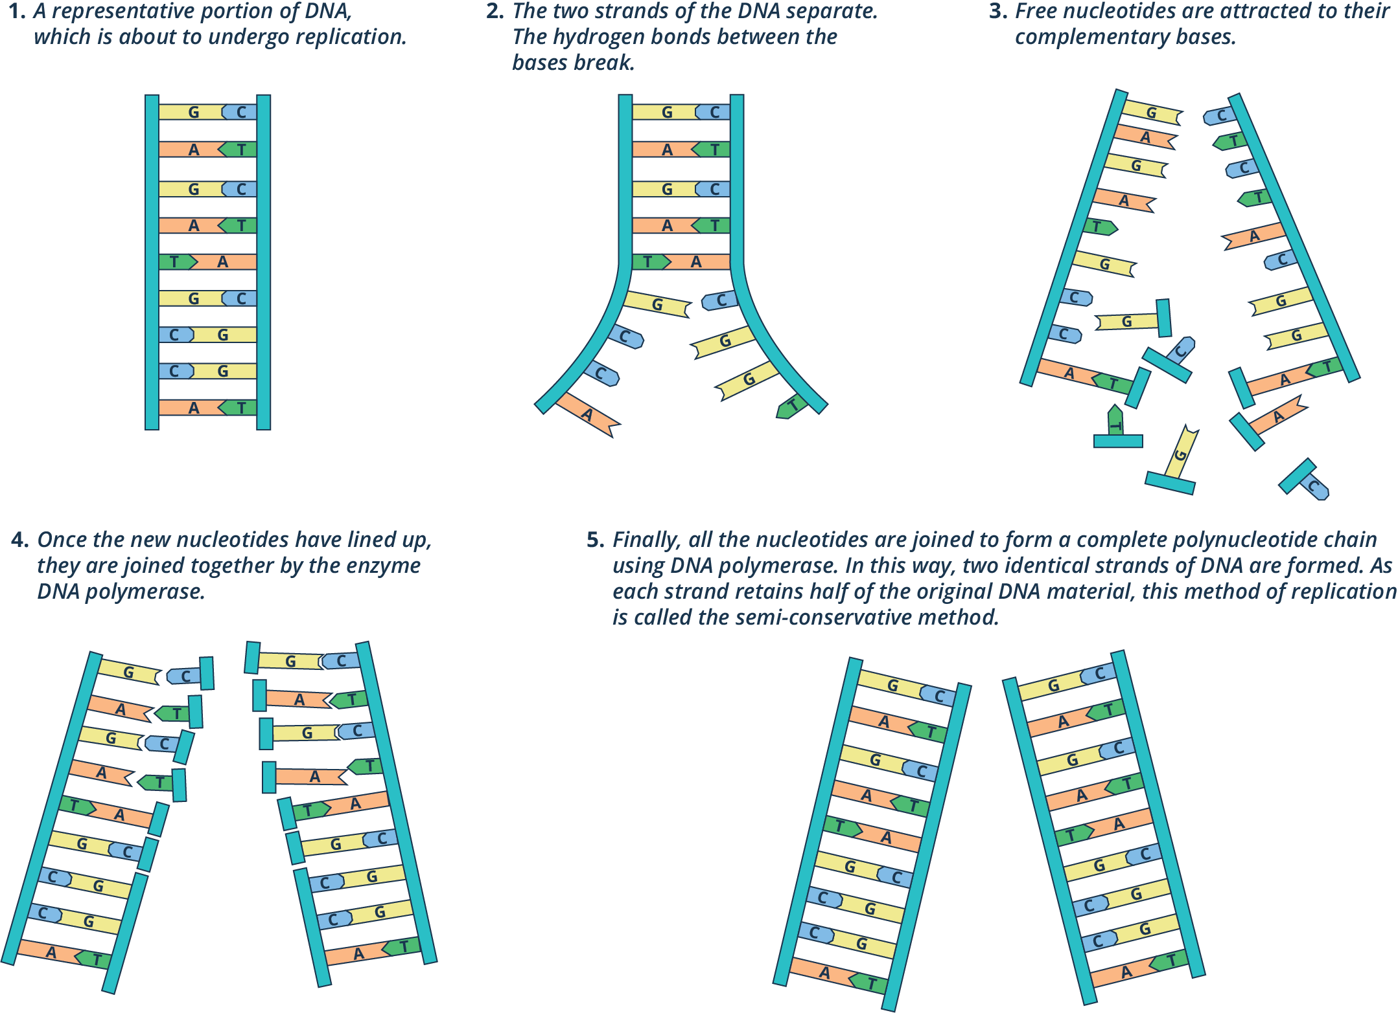
The Cell Cycle
Interphase - Gap 1
Interphase - S
Interphase - Gap 2
M phase
Cytokinesis

Slide 22
The Cell Cycle
Interphase - Gap 1
Continued growth and the production of materials that are necessary for cell division to occur
Interphase - S
Events during the Gap 2 phase
Interphase - Gap 2
Protein synthesis but not at the rate similar to that of the G1 phase
M phase
Cytokinesis

Slide 23
The Cell Cycle
Interphase - Gap 1
Mitosis or Meiosis
The M phase in eukaryotic organisms involves either one of two processes, namely, mitosis and meiosis.
Sex cells or gametes undergo meiosis, whereas somatic cells or non-sex cells undergo mitosis.
Interphase - S
Interphase - Gap 2
M phase
Cytokinesis

Slide 24
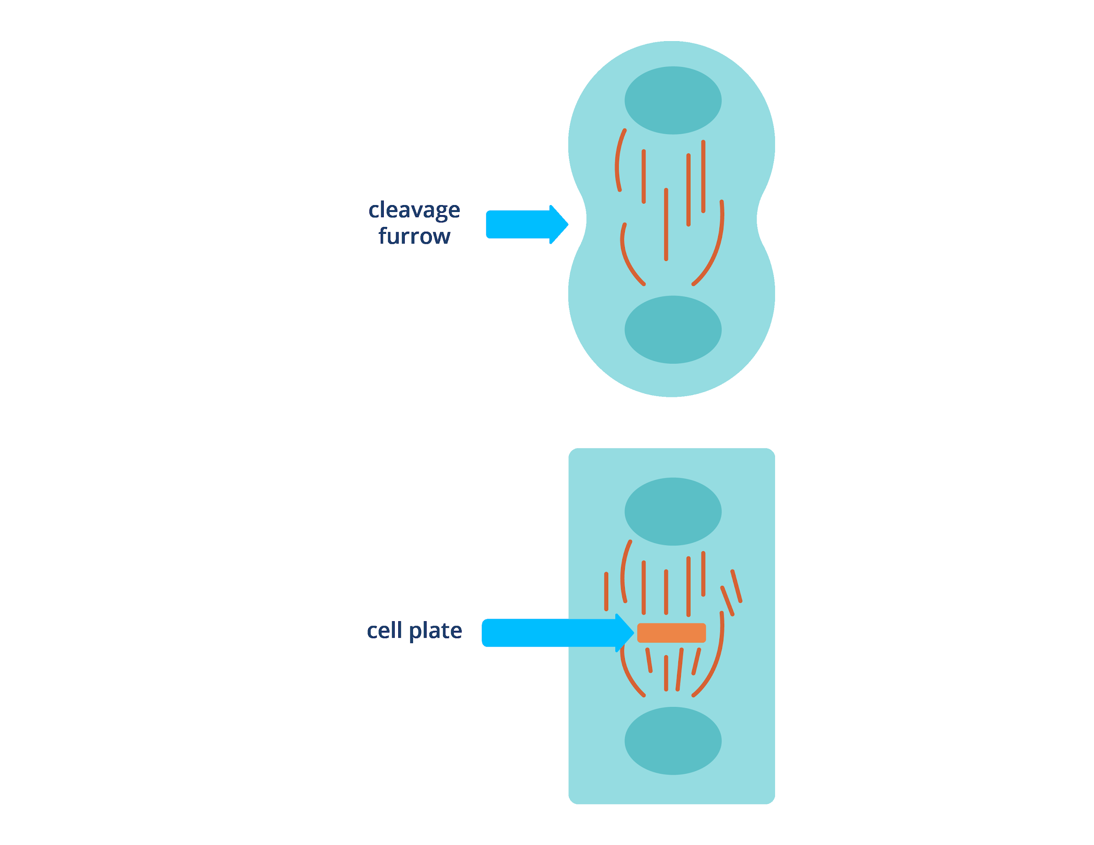
The Cell Cycle
Interphase - Gap 1
Interphase - S
Interphase - Gap 2
M phase
Cytokinesis
Cytokinesis is marked by the formation of a cleavage furrow in animal cells.

Slide 25
The Cell Cycle
Interphase - Gap 1
Interphase - S
Interphase - Gap 2
M phase
Cytokinesis
Cytokinesis is marked by the formation of a cell plate in plant cells.

Slide 26
The process of mitosis and meiosis refers to the division of the nucleus and genetic material. Cytokinesis, on the other hand, refers to the division of the cytoplasm.
Cytokinesis can only occur once the genetic material is properly distributed to the daughter cells.

Slide 27
The Cell Cycle Checkpoints
G1-to-S checkpoint
Cell Cycle Checkpoints
G2-to-M checkpoint
Metaphase checkpoint

Slide 28

The Cell Cycle Checkpoints
G1-to-S Checkpoint
G2-to-M Checkpoint
M Checkpoint
Is the cell large enough with all the necessary energy reserves and doubled organelles?
Is there any damage in the cell’s DNA?

Slide 29
The Cell Cycle Checkpoints
G1-to-S Checkpoint
G2-to-M Checkpoint
M Checkpoint
Is the DNA properly replicated?
Are the environmental conditions favorable for cell division to take place?
Is there a presence of DNA damage?

Slide 30
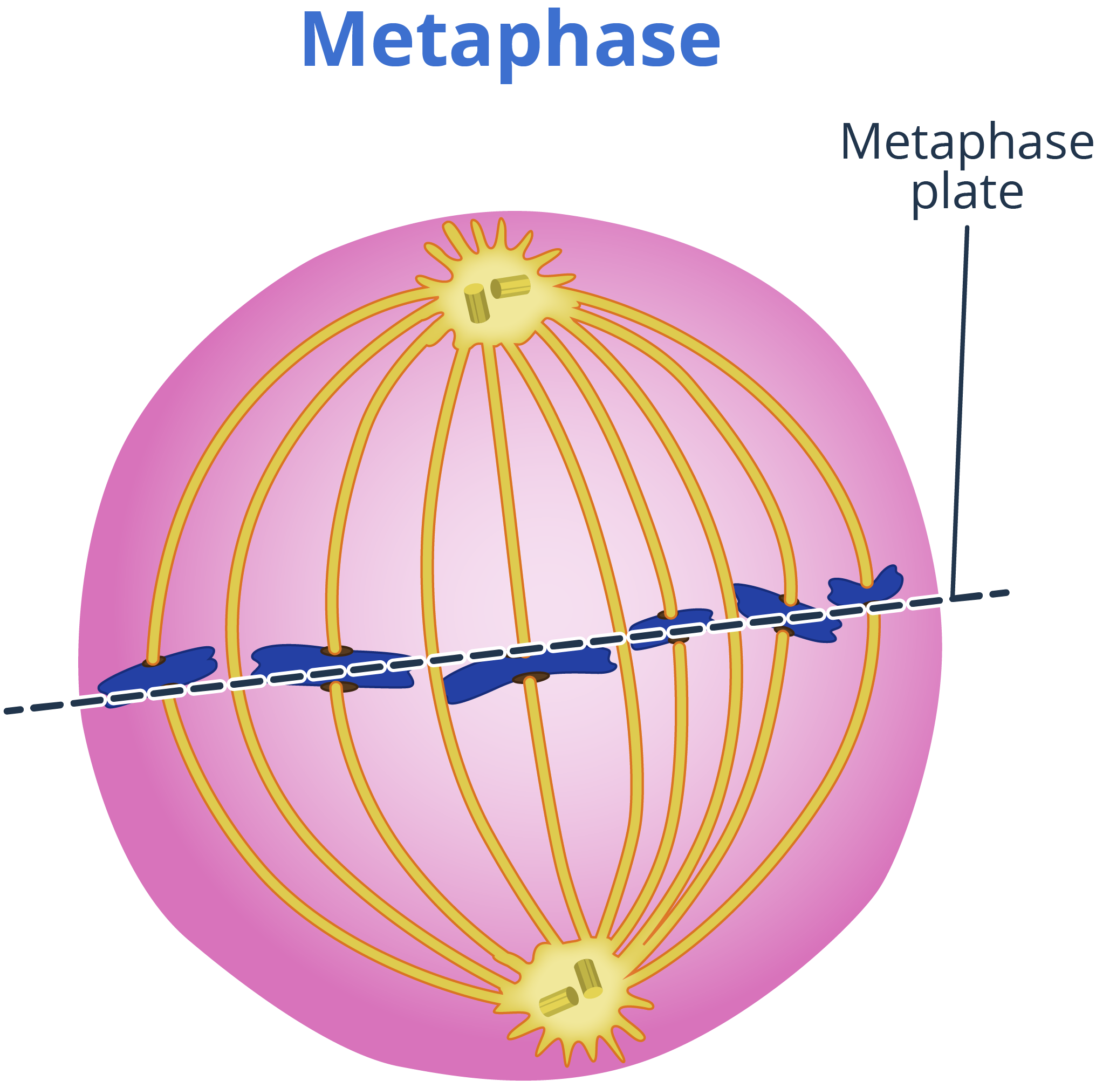
The Cell Cycle Checkpoints
G1-to-S Checkpoint
G2-to-M Checkpoint
M Checkpoint
Are the spindles properly attached?
Mitotic spindle

Slide 31
The life cycle of a cell is known as the cell cycle, and it describes how cells grow, develop, and reproduce.
With very few exceptions, all of the cells in your body contain genetic material in the form of DNA or deoxyribonucleic acid, which is usually found in the nucleus of your cells.

Slide 32
There are three main stages in the cell cycle, namely, interphase, M phase, and cytokinesis.
Interphase is the stage when the cell prepares itself for eventual cell division, which can either be mitosis or meiosis. It is also the stage when the cell is metabolically active and performs its specialized function.

Slide 33
Cytokinesis refers to the division of the cell’s cytoplasm and other components. This process significantly differs between animal cells and plant cells, primarily because of the presence of cell walls in the latter.

Slide 34
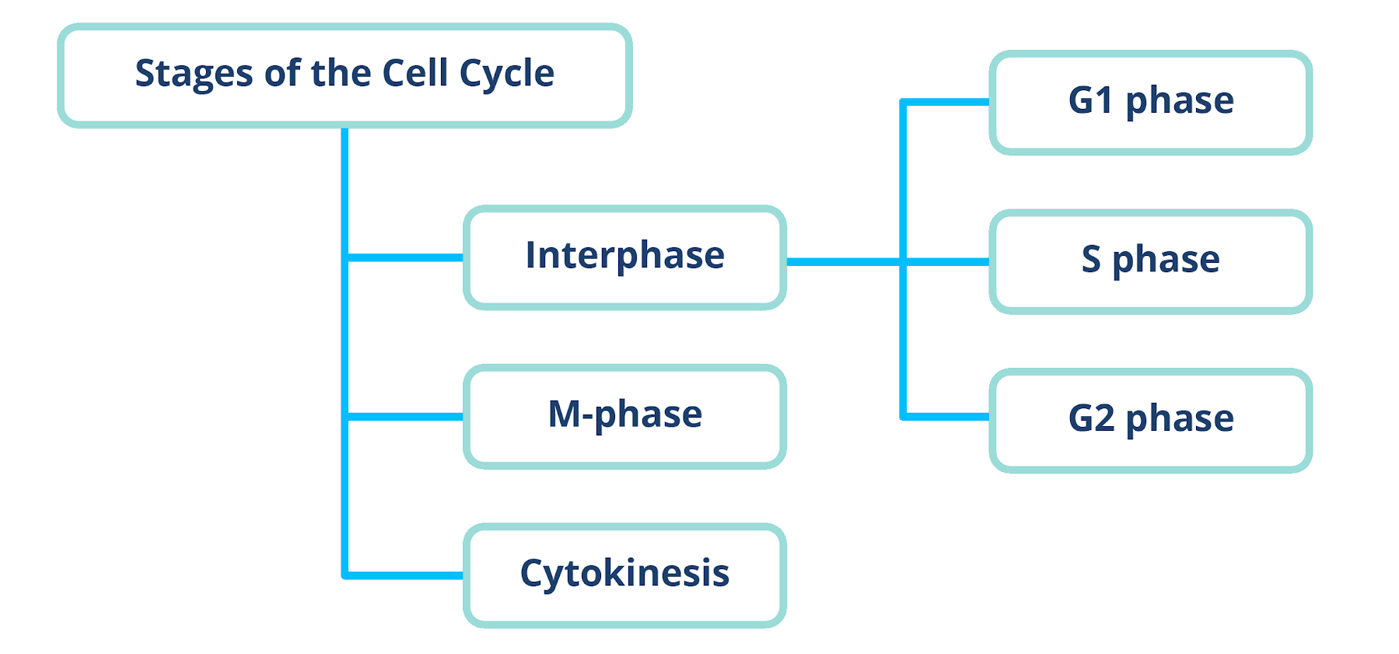
The cell cycle involves a series of events that lead to the production of cells.

Slide 35
Slides 11: Onion cells 2 by Umberto Salvagnin is licensed under CC BY 2.0 via Flickr.
Slide 12: Polytene chromosomes (26 2 97) Salivary glands of nonbiting midges larvae (Chironomidae) by Doc. RNDr. Josef Reischig, CSc. is licensed under CC-BY SA 3.0 via Wikimedia Commons.
Boyer, Rodney F. Concepts in Biochemistry. Hoboken, NJ: Wiley, 2006.
Hickman, Cleveland P. Integrated Principles of Zoology. New York, NY: McGraw-Hill, 2011.
Miller, Stephen A., and John P. Harley. Zoology. New York, NY: McGraw-Hill, 2010.
Russell, Peter J. Biology: The Dynamic Science. Student Ed. Belmont, CA: Thomson/Brooks/Cole, 2008.
Starr, Cecie, Ralph Taggart, Christine A. Evers, and Lisa Starr. Biology: the Unity and Diversity of Life. Boston, MA: Cengage, 2019.

